Slide 1
MEC 402 Casting, Welding and Forming
Dr. Arjyajyoti Goswami
arjyajyoti.Goswami@me.nitdgp.ac.in
+91-9953167384

Slide 2
Metal Transfer in Arc Welding:
What is metal transfer
Forces in metal transfer
Types of metal transfer

Slide 3
Why study about it
To understand the mechanism of the metal transfer and the forces that are active.
If we understand the phenomenon we can control the metal transfer to suit our need.

Slide 4
Metal Transfer
During arc welding the heat of the arc melts the electrode wire (along with the base metal).
Metal transfer is the process through which the molten drop of metal detaches from the electrode and reaches the weld pool.
The mode of metal transfer which is operative at any instant is dependent on the cumulative effect of the forces on the tip of the electrode. Variety of forces in operate during the process of metal transfer from the tip of the electrode to weld deposit.

Slide 5
Forces that are active during metal transfer can be broadly categorized into two.
Assisting forces – those who helps in detaching the metal droplet from tip of the electrode and aids in its transfer to the weld deposit.
Resisting forces – those who hinders the process of detachment and transfer of molten metal droplets form tip of the electrode to the weld deposit

Slide 6
Gravity Force
It is due to the weight of the droplet. It is an assisting force when electrode is pointing downwards and a resisting force when the electrode is pointing upwards.
Numerically it is equal to the weight of the molten droplet :
Fg = mg = ρvg
ρ – Density of the electrode material
v – Volume of the molten droplet
g – Acceleration due to gravity

Slide 7
Force of Surface Tension
It tends to retain the molten droplet at the tip of electrode and is a Resisting Force.
Force of surface tension depends on a number of factors like: surface tension of the molten droplet, radius of electrode, density of the electrode material.
Fs = 2 * π*ɣ*r* f(r/c)

Slide 8
Electromagnetic ‘pinch’ force (Lorentz Force)
It is an assisting force and active at the top of the electrode.
This force is hardly of any consequence in solid electrode but results in considerable influence on detachment of molten droplet from the tip of the electrode. This is referred to as Lorentz Force or the Electromagnetic Pinch Force.

Slide 9
Drag Force
This is due to flow of gas around the drop (occurs in welding processes which relies on external shielding gases like GMAW, GTAW).
This is assisting in nature. Magnitude of this force may be affected by amount of gas flow.
In a special cases it can act as an resisting force as well.

Slide 11
Types of metal transfer

Slide 12
Types of metal transfer
Free Flight Transfer
Short Circuting Transfer
Globular
Projected
Spray
Mist
Explosive
Repelled
Rotating
Short circuiting transfer

Slide 13
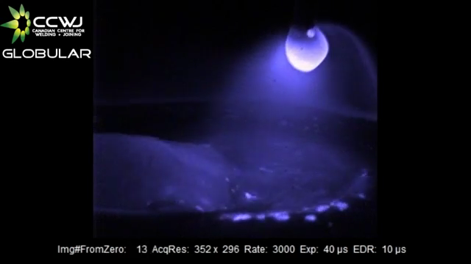
Notes:
https://www.youtube.com/watch?v=F_xr7rTVYSU&ab_channel=bhadeshia123

